Slide 1
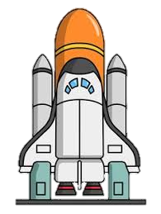


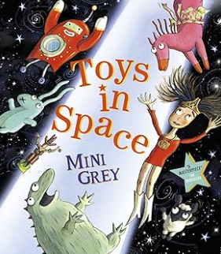
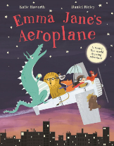
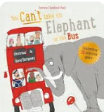

Experiences/visits/visitors
Fantasy visitors
Hidden forest doors
Potion making
Colour mixing
Pond dipping
Unicorn Poo
Fire breathing
Fairy hunt
Fairy dust
Up into Space and Back Again!
Communication and Language
By the end of Summer 1, children will:
Listen to stories, rhymes, discussions and 2 part instructions during whole class discussions and at other times of the day responding with relevant comments, questions or actions
Use full sentences to articulate actions/play independently
Use a developing vocabulary within sentences in response to speaker with a given stimulus
Begin to have two way conversations with peers about things of high interest to them
Use 'but’ and ‘so’ to join sentences
Use an appropriate voice to represent common emotions e.g. sad/happy and adjust volume of their voice to the situation
Independently use friendship questions and responses.
Off to the Moon
Key Texts
Nursery Rhymes, songs, poetry:
Green Eggs and Ham Dr. Seuss
The Smallest Girl in the Class Justin Roberts
How to make a unicorn
The legend of the Loch Ness Monster
Room on the Broom
The Kiss that Missed
Knights and Castles Non-Fiction
How to grow a unicorn
Jack and the Beanstalk
Where the Wild Things Are
Into the Forest
On the Way Home
The Princess and the Giant
Billy and the Beast
The Smartest Giant in Town
Sugar Lump and the Unicorn
Naughtiest Fairy
Prince Cinders
Twisted Fairy Tales
Smeds and Smoos
Here come the Aliens
Beegun
10 little pirates
Sunk in the night Pirates
Think Big Book
Foggy, Foggy Forest
Meet the Planets!
Who can we find in Space?
Indoors/Outdoors
Superheroes
Desert Islands
Fairy land
Giant land
Witches lair
Physical Development
By the end of Summer 1, children will:
Effectively run, jump hop, climb, dance and skip at varying speeds
Negotiate space and obstacles in the environments considering themselves and others
Balance
Use two wheeled toys to manoeuvre around a route
Use the wrist pivot of their dominant hand, and sometimes both, to make marks and show control over small equipment and apparatus
Carry out the safe movement of larger equipment, showing balance, control and coordination
Show energy and enthusiasm while performing large movements
Hold a pencil effectively and on most occasions with a tripod grip
Use a selection of small tools with developing accuracy, control and effectiveness, such as scissors, brushes, and cutlery
Take care when drawing a picture
Dress and undress knowing when they are hot/cold.
Independently get a drink when hot or thirsty.
Above the cities! London, Paris, Italy, New York, Beijing, Sydney!
Personal, Social and Emotional Development
By the end of Summer 1, children will:
Express how they are feeling in the moment
Can use resources independently to help turn taking
Follow instructions appropriately
Be resilient and preserve through a task independently
Be able to explain the need for rules and learning behaviours (to keep us safe and happy)
Begin to narrate how they are keeping their body healthy independently
Learn how to keep safe
Explain to others why it is important to share and take turns.
Have secure friendships and companions.
Express positive thoughts and actions towards familiar adults.
Value of the term – Courage, Ambition, Pride, Respect
Who can fit on the bus!?
Teddy’s trip on the train and the Lost Property Office!
Self – Regulation
By the end of Summer 1, children will:
Zones of Regulation

