Slide 1


Teaching and Learning Phonics at Queen’s Park School.

Slide 2
Aims of the session
To share information about what phonics is and how it is taught at Queen’s Park.
To teach the basics of phonics and some useful phonics terms
To give tips and suggestions about how you can support your child.
To provide an opportunity for questions.

Slide 3
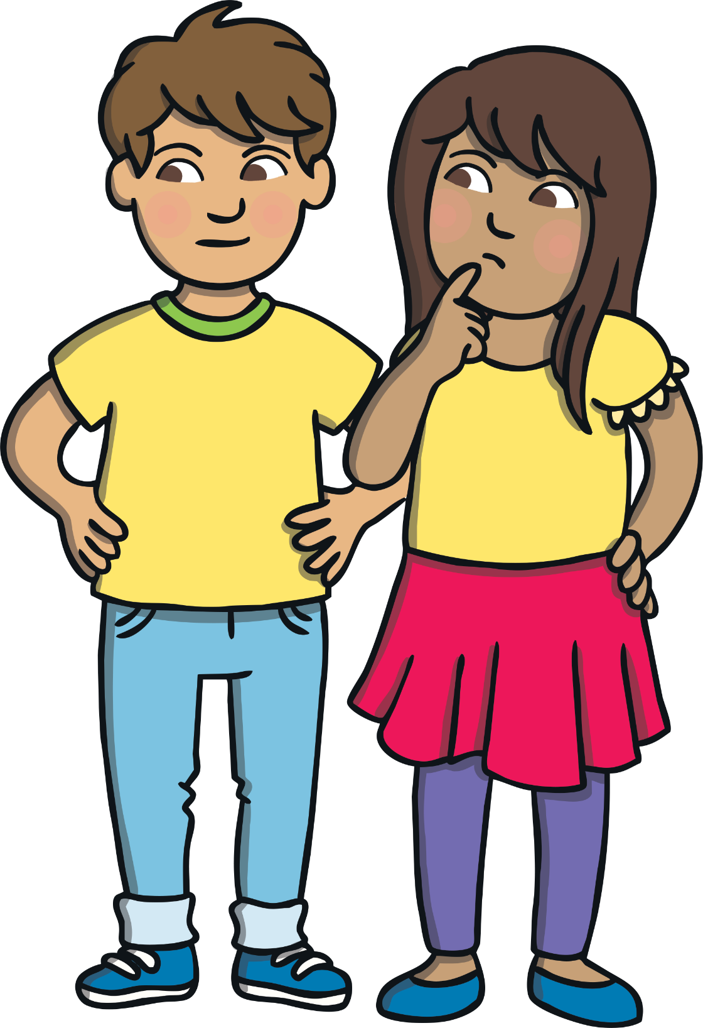
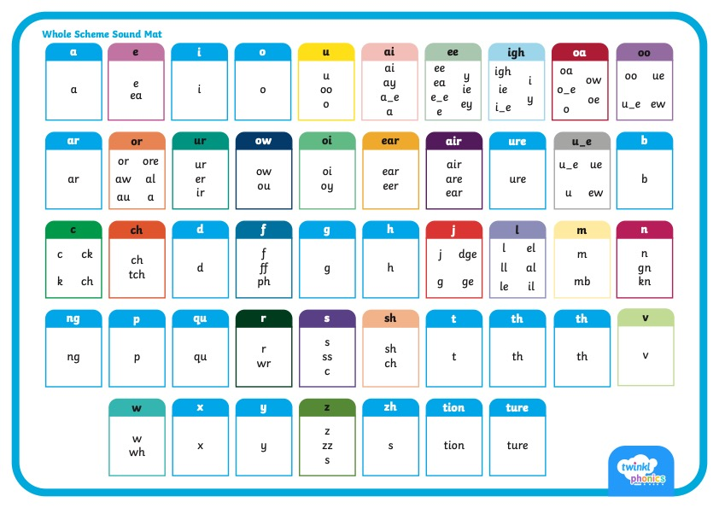
      Did You Know…?
There are 26 letters in the alphabet but there are 44 sounds and over 100 different ways of spelling them.
This is why English is one of the most complex languages to learn!
Notes:
English is a mix of Latin, French,

Slide 4
What Is Phonics?
Phonics is a method for teaching reading and writing.
It develops phonemic awareness – the ability to hear, recognise and use the sounds within words.
It teaches the correspondence between phonemes (sounds) and the graphemes (letters) that represent them.
Phonics is currently the main way in which children in British primary schools are taught to read in their earliest years.
Children will also be taught other skills, such as whole-word recognition (see ‘tricky words’), book skills and a love and enjoyment of reading.

Slide 5
At Queen’s Park we use ‘The Twinkl Systematic Synthetic Phonics Programme’ to teach phonics. This is split into 6 levels.
In Reception we aim to cover Levels 1 – 4.
In Y1 we aim to cover Level 5
In Y2 we aim to cover level 6
Every child in Reception, Y1 and Y2 learns daily phonics at their level. This is approximately 30 mins a day.

Slide 6
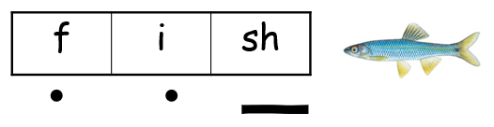
Phonics Terminology
Phoneme - Phonemes are sounds that can be heard in words e.g. c-a-t.
Grapheme - This is how a phoneme is written down
e.g. ai ay a a-e
Blending - Children need to be able to hear the separate sounds in a word and then blend them together to say the whole word
Segmenting - Children need to be able to hear a whole word and say every sound that they hear. Segmenting is breaking a word down into separate letter sounds.
Decode - The ability to segment and blend words.
Phoneme frame - We say each phoneme and blend them
Sound buttons together to read the word
.

Slide 7
Phonics Terminology
Digraph - This means that the phoneme comprises of two letters that make one sound.
e.g. ai, ck, sh, ss
Split Digraph -A phoneme with two letters which are separated by another letter.
E.g. make like stone
Trigraph - This means that the phoneme comprises of three letters e.g. air, ear, ure, igh
Tricky Words
(Common Exception
Words)
.
Words which can’t be blended; children learn to read at sight.
I go no to the into

Slide 8
      Twinkl Phonics
What are the six levels?

Slide 9
Level 1: Nursery - Getting ready for phonics
Increasing children’s Sound Awareness
Hearing and discriminating between environmental sounds.
Hearing and discriminating between instrumental sounds
Hearing the sounds that our bodies make (e.g. clapping, stamping)
Rhythm and rhyme
Alliteration
Voice sounds
Oral blending and segmenting (e.g. hearing that d-o-g makes ‘dog’)

Slide 10
Level 2: Reception
Children will learn their first 19 phonemes/ graphemes (pure sounds):
Set 1: s a t p Set 2: i n m d
Set 3: g o c k Set 4: ck e u r
Set 5: h b l f ff ll ss
They will use these phonemes to read and spell simple “consonant-vowel-consonant” (CVC) words:
sat, tap, dig, duck, rug, puff, hill, hiss
All these words contain 3 phonemes.

Slide 11
Level 3: Reception
Children will enter Level 3 once they know the first 19 phonemes and can blend and segment to read and spell CVC words.
They will learn another 26 phonemes:
j, v, w, x, y, z, zz, qu
Consonant digraphs: ch, sh, th, ng.
ai, ee, igh, oa, oo, ar, or, ur, ow, oi, ear, air, ure, er
They will use these phonemes (and the ones from level 2) to read and spell words:
chip, shop, thin, ring, pain, feet, night,
boat, boot, look, farm, fork, burn,
town, coin, dear, fair, sure
They will learn new common exception (tricky) words

Slide 12
Level 4: Reception
Children will enter phase 4 once they know all of the level 2 and 3 phonemes and can blend and segment to read and spell CVC words.
They will not learn any new phonemes in this level.
They will learn to blend adjacent consonants at the beginning and end of words.
st, bl, fl, nk, spl, spr
They will learn new common exception (tricky) words

Slide 13
Level 5: Year 1
learn alternative graphemes for known phonemes e.g. ou (shout) saying ow (cow)
learn alternative pronunciations of known graphemes e.g. ch (church) saying ch (chef)
introduce split digraphs make bike these
introduce suffixes and prefixes:
unkind warmer coldest jumped chairs foxes
learn to read and spell more common exception words.

Slide 14
Level 6: Year 2
develop children’s knowledge of spelling patterns and best-guess grapheme selection
learn more alternative graphemes for known phonemes
learn more alternative pronunciations for known graphemes
develop an understanding of the spelling rules for adding suffixes and prefixes
introduce homophones/near homophones and contractions
learn to spell more common exception words;
develop their understanding of grammar rules
learn effective writing techniques including editing and proofreading

Slide 15
Children are introduced to a new sound through a story (s).
Children learn an action to help them remember the sound.
Children listen to words containing the sound (snake, horse).
Children learn a handwriting phrase to help them write the letter .
Children begin to orally blend simple words (sun, sat).
Children will encounter the sound in the indoor and outdoor environment.
A Twinkl Lesson in Reception

Slide 16
Continue to read daily; poetry, songs, fiction and non-fiction; talk about what you read to help develop comprehension.
Learn the Twinkl actions to help your child remember the sounds they learn.
Notice words which contain the sound children are learning.
Use the handwriting phrases and practice forming letters in a fun way (in the air with a pointy finger, in sand, in the bath, etc.).
Complete the weekly homework linked to the sounds we have learned.
How can I support my child?

Slide 17
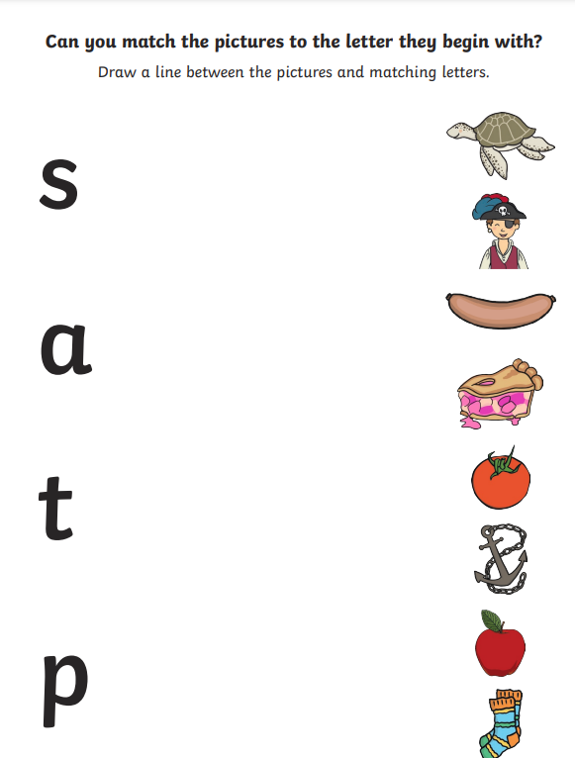
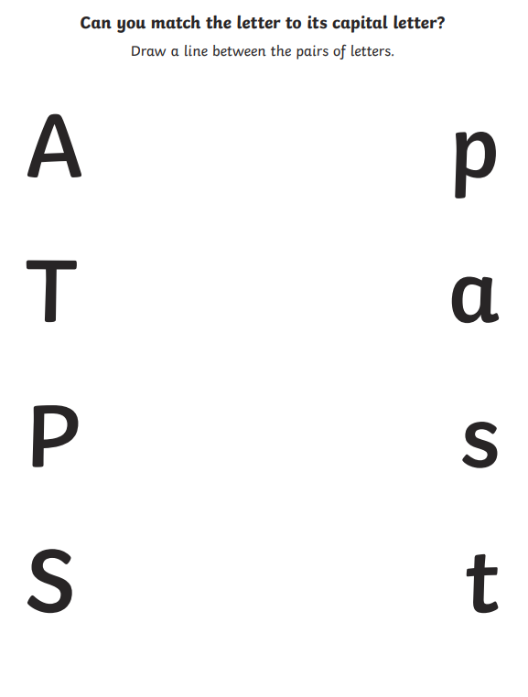
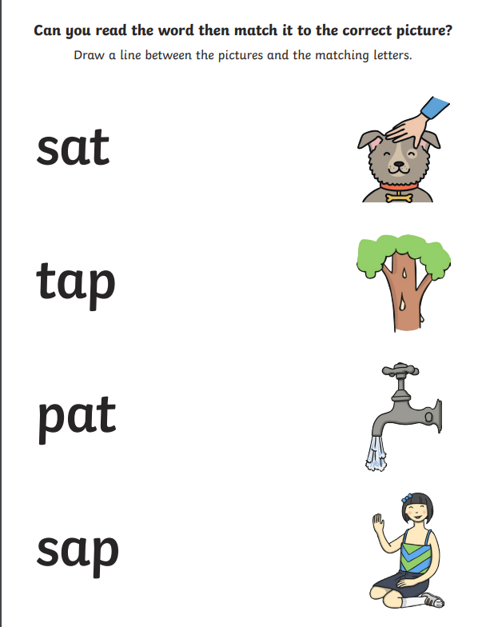

Slide 18
Have a go at oral blending. Say the sounds in simple words like s-u-n and see if your children can say the whole word. *Remember they must be pure sounds!
Once your child starts bringing home a reading book, have a go at reading every day. You could read the book to your child first to give them the confidence to have a go on their own. It’s not a test!
Playing games such as I Spy….something beginning with ssss
How can I support my child?

Slide 19
How can I support my child?
Useful Twinkl links to help support your child in phonics and reading:
1. Actions for Level 2 sounds:
https://www.youtube.com/watch?v=0SzkjubQ-Ok
2. Information about pure sounds:
https://www.youtube.com/watch?v=T7iMt_9176w
3. Twinkl Tricky Word Songs:
https://www.youtube.com/watch?v=andH6QuDoNI
4. Information about Twinkl Phonics and Rhino Reader Books:
https://www.youtube.com/watch?v=mf6Hy-dSLt8
5. Information about Twinkl Phonics Web games:
https://www.youtube.com/watch?v=KwrhROaK8V8

Slide 20
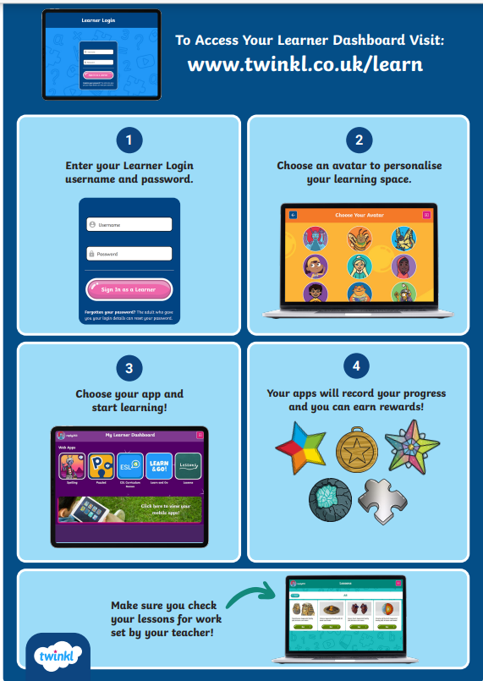
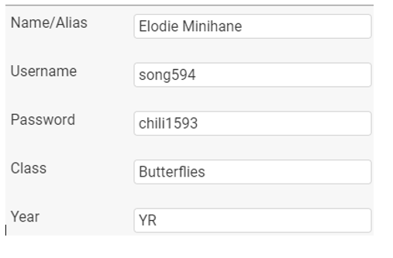
Rhino Readers and Twinkl learner
Rhino Readers are Twinkl’s levelled books which match the sounds your child is learning. The main characters are familiar – Kit, Sam, Mum and Dad.
Twinkl learner is a simple, online platform where you can access books and games that have been set by the teacher. Your child will receive their own personal login details after we have started teaching the level 2 phonics.

